Slide 1
Introduction HTML and
HTML Elements and Attributes
Session 2
(slot 2-3)

Slide 2
Contents
Introduction to HTML
Explain the basic and formatting elements.
Explain the HTML Attributes
Explain the image element.
Explain hyperlinks.

Slide 3
HTML Introduction
HTML stands for Hyper Text Markup Language
A markup language is a set of markup tags
HTML documents are described by HTML tags
Each HTML tag describes different document content

Slide 4
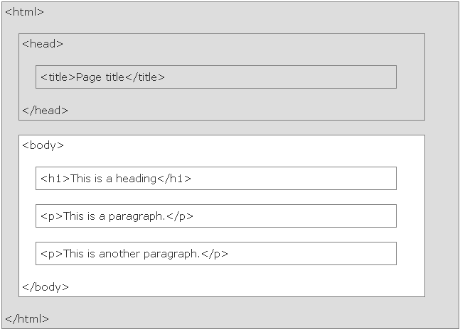
HTML Page Structure
<!DOCTYPE html>
declaration helps the browser to display a web page correctly
provides information about the document
<meta charset="UTF-8">
Only the <body> area (the white area) is displayed by the browser.
Notes:
<!DOCTYPE html> : khai báo cho trình duyệt hiểu được người dùng đang sử dụng HTML 4 hay HTML 5
<meta charset=“UTF-8”> : khai báo cho phần body hiểu được Tiếng Việt

Slide 5
HTML Elements
HTML tags are keywords (tag names) surrounded by angle brackets:
<tagname>content</tagname>
ex: <h1>this is heading 1</h1>
HTML elements with no content are called empty elements.
ex: <br /> (thẻ ép xuống dòng)
Nest HTML elements can be nested (elements can contain elements)
  ex: <head><title>welcome</title></head>
  (có thể lồng vào nhau)

Slide 6
Basic elements
Providing a flow to the contents.
Making the web page comprehensible.
  P
  BR (xuống dòng)
  HR (tạo 1 đường kẻ ngang)
  H1 – H6
  PRE (không dung nữa)

Slide 7
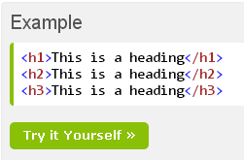
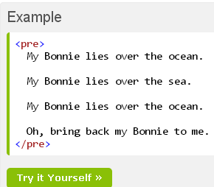
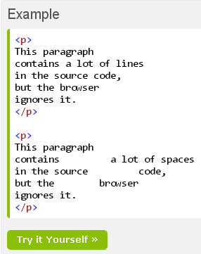
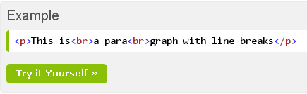
Basic elements
Notes:
Thẻ <h>type</h> càng lớn thì chữ trên web càng nhỏ. z

Slide 8
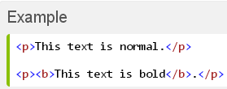
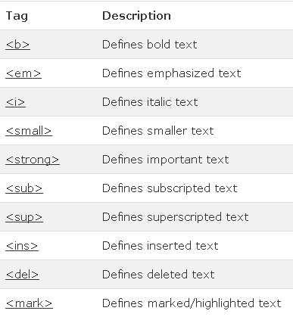

HTML text formatting elements
Notes:
<i> , <em>: in nghiêng
<strong> = <b> : in đậm
<sub> : làm số or chữ nhích xuống, like H2O
<sup> : làm số or chữ nhích lên, like x mũ 2
<ins> gạch dưới
<del> gạch xóa đè lên chữ

Slide 9
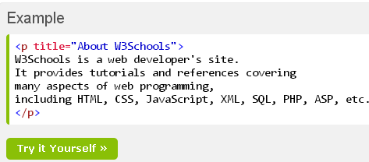
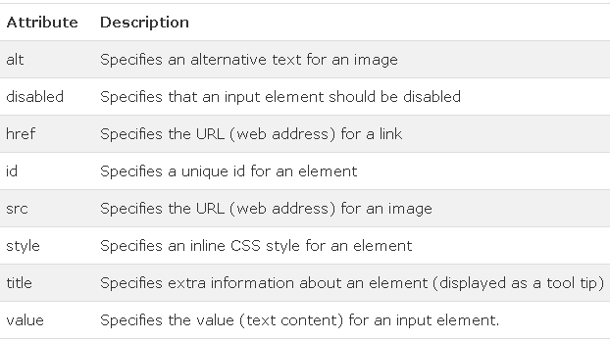
HTML Attributes
HTML elements can have attributes
Attributes provide additional information about an element
Attributes are always specified in the start tag
Attributes come in name/value pairs like: name="value"

Slide 10
Character entity
Symbol name | Entity name | Entity number
Ampersand (&) | &amp; | &#38;
Greater than (>) | &gt; | &#62
Less than (<) | &lt; | &#60
non-breaking space (khoảng trắng) | &nbsp; | &#160
Quotation mark (“ “) | &quot; | &#34

Slide 11
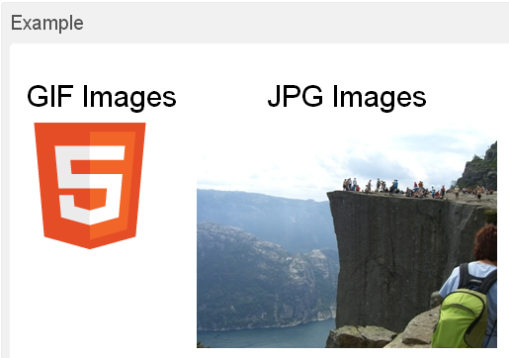
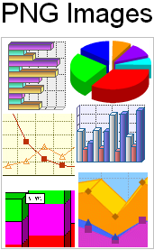
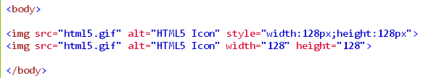
Image Element
SRC
WIDTH
HEIGHT
ALT
ALIGN
USEMAP
Notes:
SRC: chỉ nguồn
ATL:
ALIGN: căn lề
USEMAP: biến tấm ảnh thành bản đồ

Slide 12
Image maps
There are different areas that act as links in an image.
  Map element
  AREA element

Slide 13
Image maps
<BODY>
<H2>Search engines</H2>
<MAP name="searchmap">
<AREA href="http://www.google.com" alt="Google" shape="rect” coords="0,0,170,35"/>
<AREA href="http://www.ask.com" alt="Ask" shape="rect” coords="0,28,170,70"/>
</MAP>
<img src="SearchEngines.JPG" alt="Search Engines" width="286" height="99" usemap="#searchmap"/>
</BODY>

Slide 14
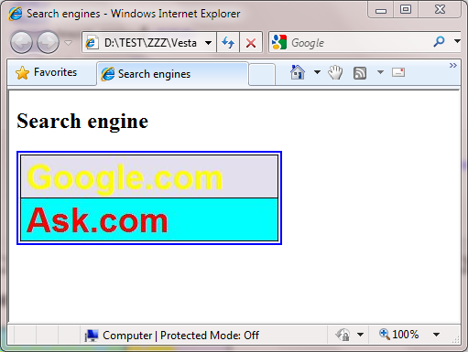

Image maps

Slide 15
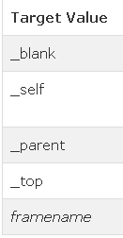

Hyperlinks
A hyperlink is a text or an image you can click on, and jump to another document.
HREF
ID
TARGET
<a href=“url” target=“…”>link text </a>

Slide 16
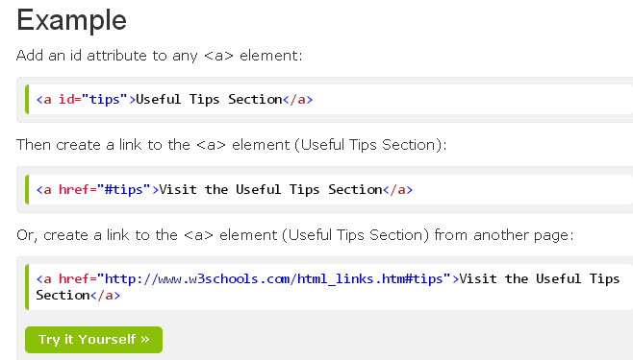
Hyperlinks

Slide 17


Other Elements
Comment
Video(HTML5)
Object

Slide 18
Other Elements
Meta

Slide 19
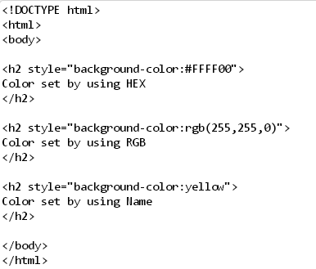
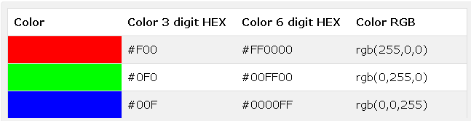
Color Values

Slide 20
Summary
Basic text elements providing a flow to the contents.
W3C defined 16 color name for HTML.
Phrase elements display code in different font emphasizing with a different look.
There are different areas that act as links in an image.
hyperlink allows jump to another document

Slide 21
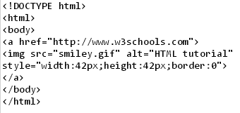
Exercise 1

Slide 22
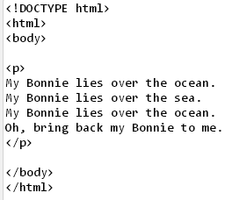

Exercise 2

Slide 23
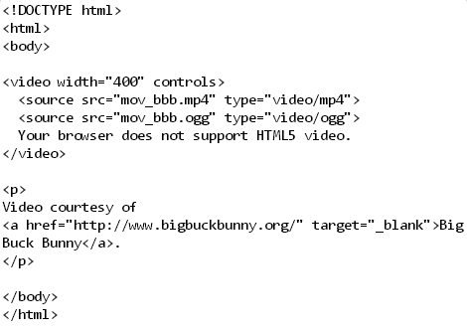
Exercise 3

